Slide 1
The Periodic Table

Slide 2
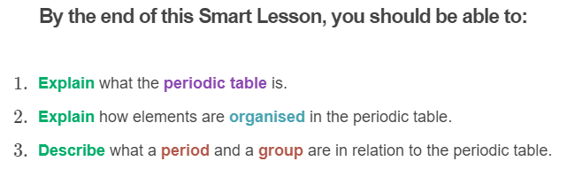
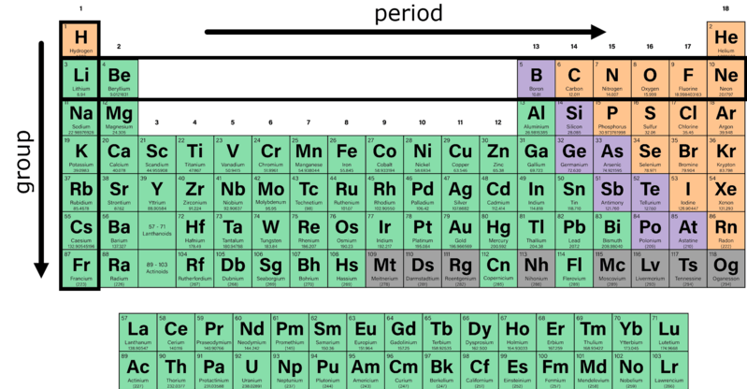

Slide 3
Different elements have different properties because their atoms are different.
In the 1850s, Robert Bunsen discovered that when different elements are heated, they produce bands of light with colours unique to that element. This is how we get different coloured fireworks!

Slide 4


Slide 5
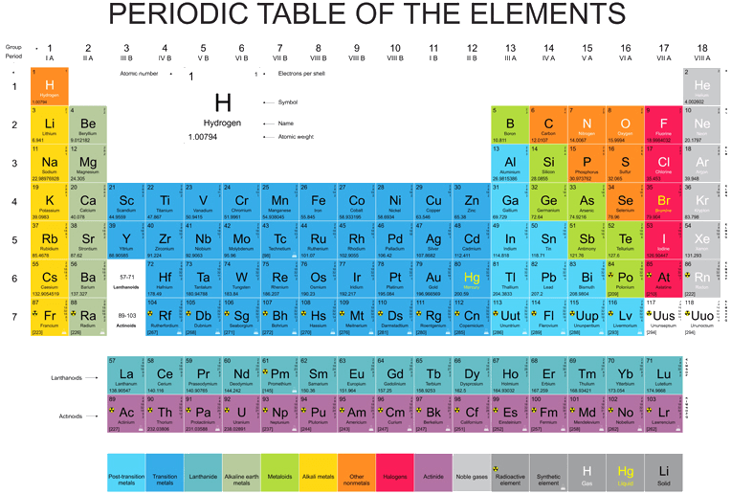
Elements are different because they have different numbers of protons, neutrons, and electrons.
There are currently 118 known elements. They can all be organised based on their chemical similarities into a table called the periodic table.

Slide 6
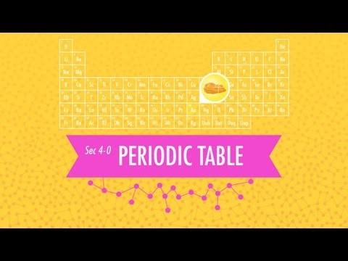

Slide 7
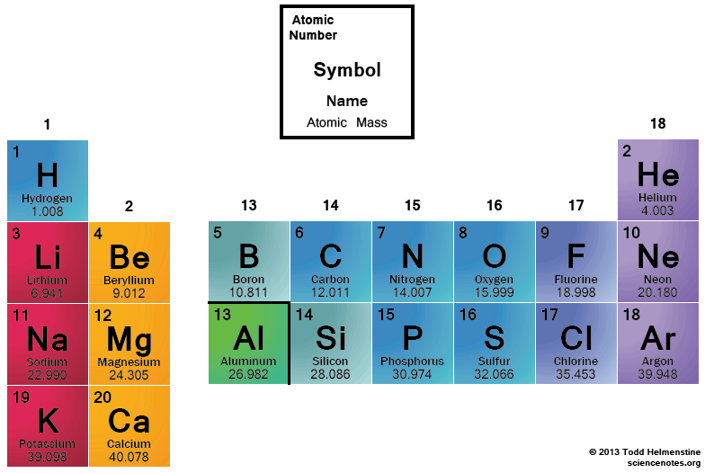
Elements in the periodic table are organised according to increasing atomic number (number of protons).
For example, hydrogen has an atomic number of 1 and is the first element in the table. Helium has an atomic number of 2 and is the next element in the table.

Slide 8
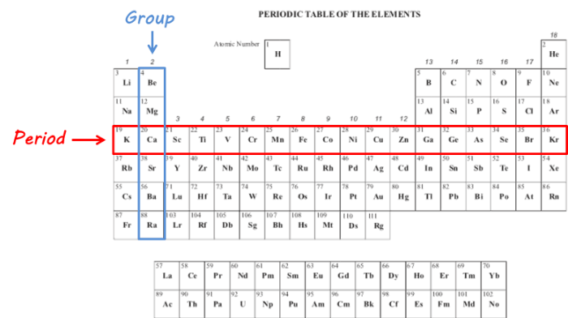
The periodic table is also organised into periods and groups.
Periods are the horizontal rows across the table and groups are the vertical columns down the table. Periods and groups are also given numbers to identify them.

Slide 9
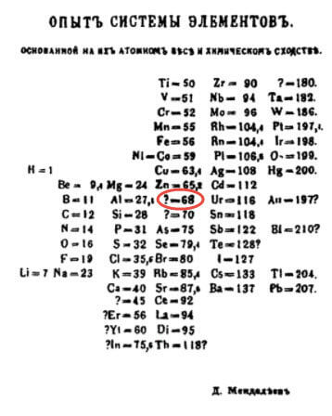
The amazing thing about Mendeleev's periodic table was that he left gaps for undiscovered elements, and predicted the properties of these elements.
Left: Mendeleev's original periodic table. When Mendeleev was developing the periodic table, he predicted that there would be an element found below aluminium on the periodic table with an atomic mass of about 68 and a density of 5.9 g/mL.

Slide 10
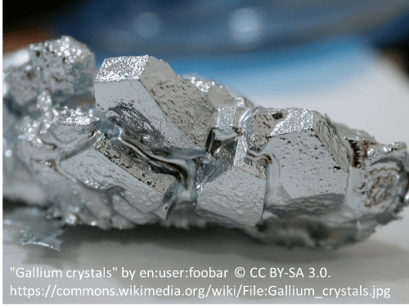
In 1875, an element that was similar to aluminium was discovered, which had an atomic mass of 69.7 and a density of 5.91 g/mL.
It was called gallium!

